Slide 1
Evaluate Forecasting Performance

Slide 2
Splitting data
One thing that we should avoid if we want to build a reliable forecasting model is training and evaluating the model on the same data set. We should always validate our model using a different data set.
Otherwise, we could run the peril of getting an over-fitted model.

Slide 3
Splitting data
We should split our data set into two subsets:
a training set – used to build the model
a test set (validation set) – used to measure the effectiveness (the forecasting accuracy) of the model

Slide 4
Splitting data
In machine learning, data set splitting (partitioning) is done at random.
With time series, this method is not adequate, because our data would lose its chronological sequence.

Slide 5
Splitting data
To split a time series, we cut it into two periods:
an early period (moments 1, 2, 3, …, k)
a later period (moments k + 1, k + 2, …, n)

Slide 6
Splitting data
the early period represents the “past” (our training set)
the later period represents the “future” (our test set).
We will use the test set to measure our forecast accuracy.

Slide 7
Splitting data
When we make forecasts for the future, it is recommended to join the two partitions again.
So we join training set and test set and perform the forecasts using the whole series. This way, the future values estimations are likely to be more accurate.

Slide 8
Splitting data
As a rule of thumb, the length of the validation period should be at least equal to the forecasting horizon.
Example: if we intend to make forecasts for 6 months in the future, the validation set should comprise at least 6 months.

Slide 9
Accuracy Metrics

Slide 10
Accuracy metrics
Classical goodness-of-fit measures like R squared are not appropriate for time series (they do not actually indicate the model capability to provide accurate forecasts).
Some specific metrics for assessing forecasting precision were devised.

Slide 11
Accuracy metrics
Forecasting error for each moment in time:
e_{t} = y_{t} - F_{t}
(The smaller the errors, the better the model.)

Slide 12
Accuracy metrics
Suppose that the validation period has p moments.
So in this period we have t = 1, 2, …, p.

Slide 13
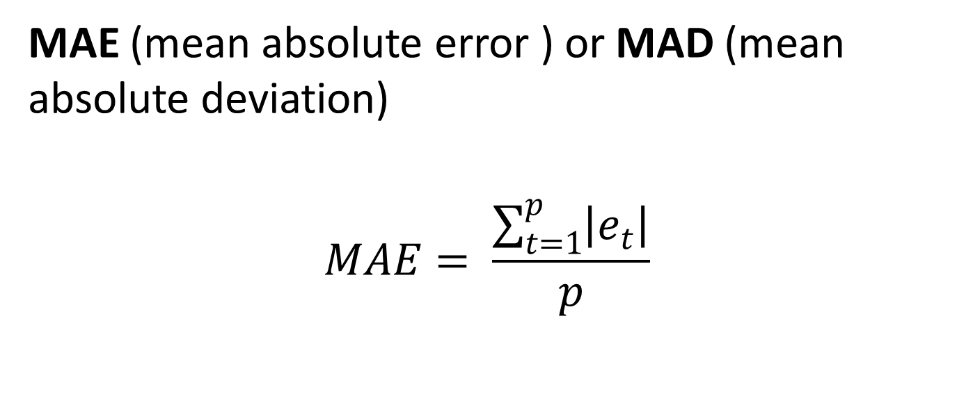
Accuracy metrics
MAE (mean absolute error ) or MAD (mean absolute deviation)
$$MAE= \frac{\sum_{t=1}^{p}{\left|e_{t}\right|}}{p}$$

Slide 14
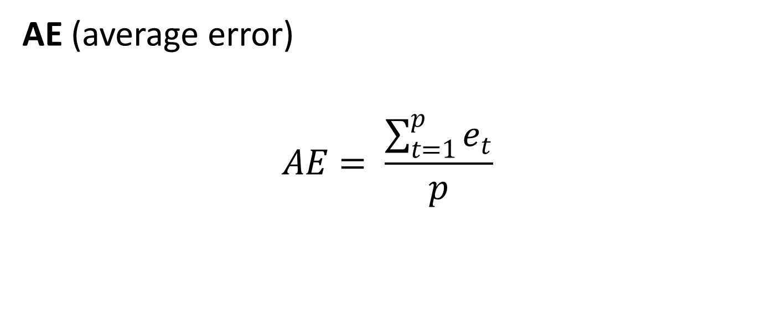
Accuracy metrics
AE (average error)
$$AE= \frac{\sum_{t=1}^{p}{e_{t}}}{p}$$

Slide 15
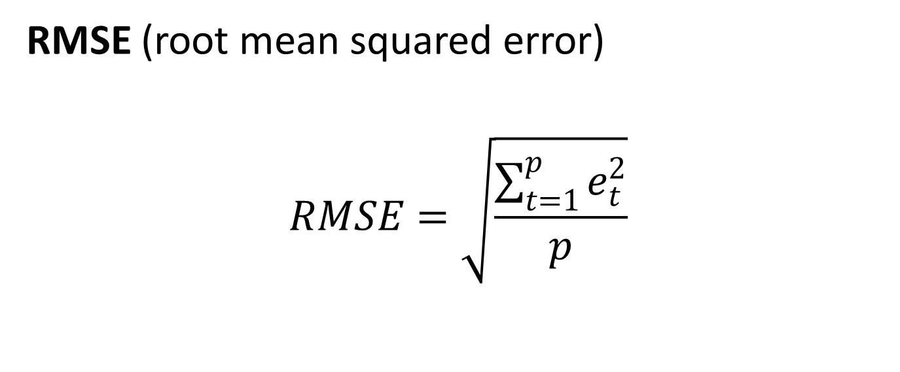
Accuracy metrics
RMSE (root mean squared error)
$$RMSE=\sqrt{\frac{\sum_{t=1}^{p}{e_{t}^{2}}}{p}}$$

Slide 16
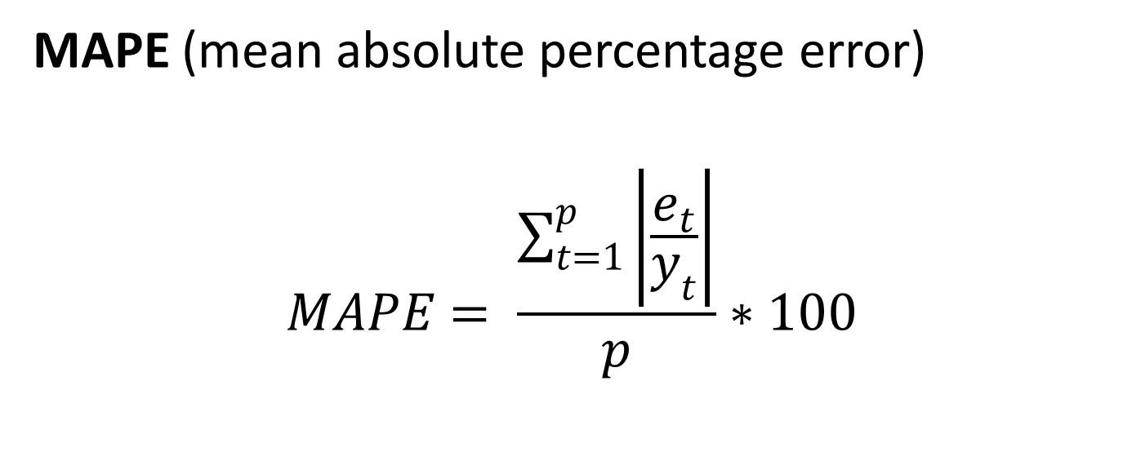
Accuracy metrics
MAPE (mean absolute percentage error)
$$MAPE= \frac{\sum_{t=1}^{p}{\left|\frac{e_{t}}{y_{t}}\right|}}{p}∗100$$

Slide 17
Accuracy metrics
To interpret MAPE we can use the following cutoff points:
< 10% very accurate forecast
10% - 20% accurate forecast
20% - 50% reasonable forecast
> 50% inaccurate forecast

Slide 18
Accuracy metrics
MASE (mean absolute standard error)
This indicator measures our model accuracy against the accuracy of the naïve forecasting.
To compute it, we have to use data from both training set and validation set. So we are going to use the following notations:
Training set: t = 1, 2, …, n
Validation set: t = n + 1, n + 2, …, n + p

Slide 19
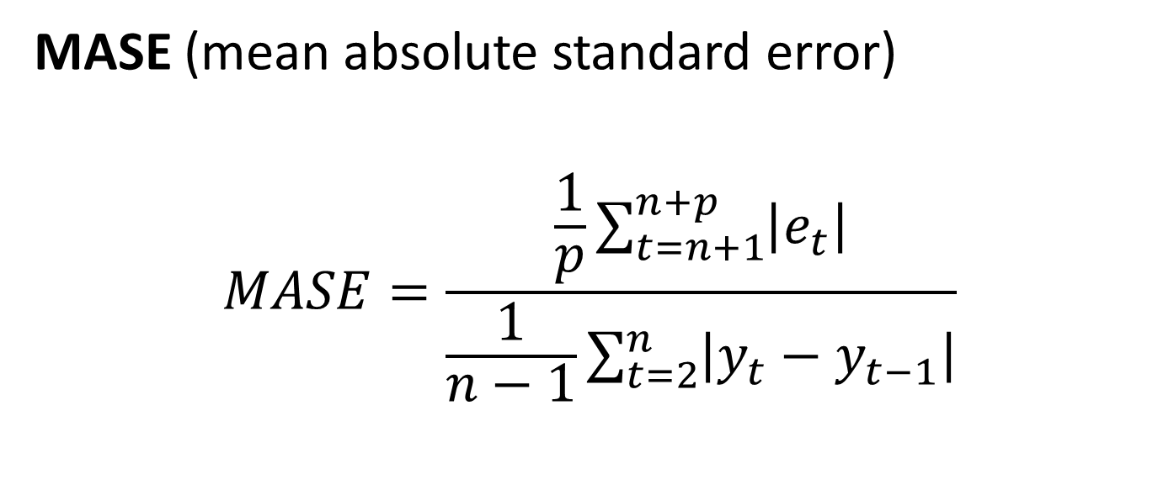
Accuracy metrics
MASE (mean absolute standard error)
$$MASE=\frac{\frac{1}{p}\sum_{t=n+1}^{n+p}{\left|e_{t}\right|}}{\frac{1}{n−1}\sum_{t=2}^{n}{\left|y_{t}−y_{t−1}\right|}}$$

Slide 20
Accuracy metrics
MASE interpretation:
MASE < 1 – our prediction is better than the naïve forecast
MASE > 1 – our prediction is worse than the naïve forecast

Slide 21
Forecasting Errors

Slide 22
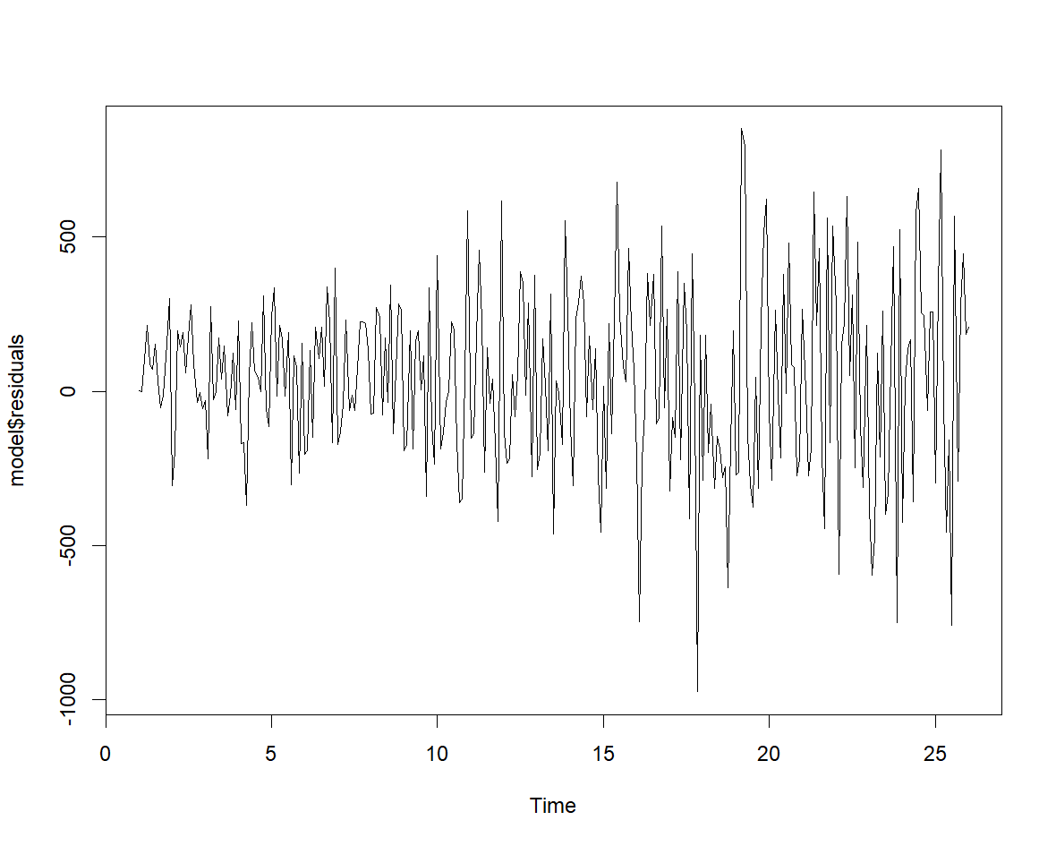
Forecasting errors
Visualize errors (line plot)

Slide 23
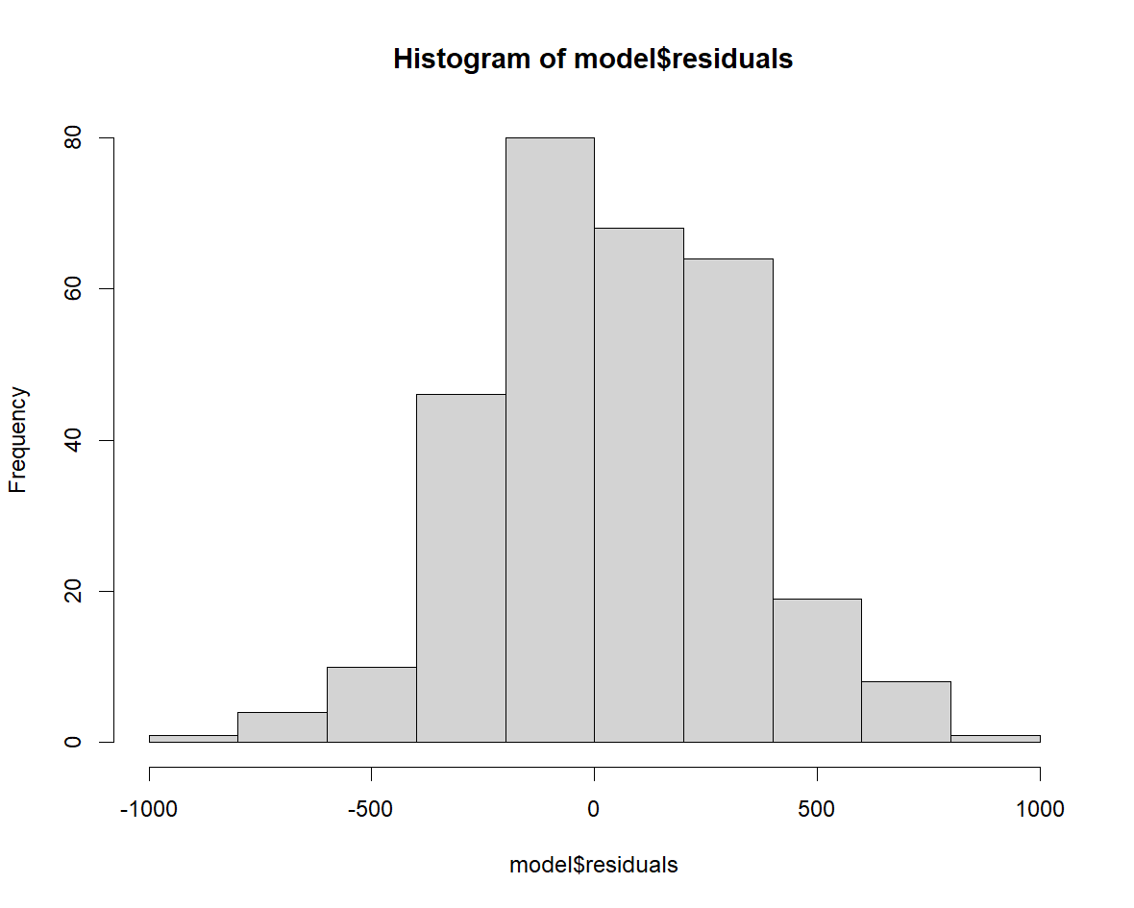
Forecasting errors
Visualize errors (histogram)

Slide 24
Forecasting errors
Underprediction (positive errors) or overprediction (negative errors)?
if we predict inventory volumes, underpredictions are more dangerous than overpredictions. In this situation we are interested in the positive errors.
if we predict income or profits, overpredictions could be more undesirable than underpredictions. In this case we will analyze the negative errors.

Slide 25
Forecasting errors
Prediction intervals
Confidence level: usually 95%
Prediction intervals can give us a clear idea about the forecast uncertainty.

Slide 26
Forecasting errors
Suppose we use two models to forecast a time series, and the one-step ahead forecast is the same for both (100). However:
for the first model, the 95% prediction interval is (92, 108)
for the second model, the 95% prediction interval is (80, 120)
The second model has much more uncertainty than the first one.

